Slide 1
Network Models

Slide 2
LAYERED TASKS
We use the concept of layers in our daily life. As an example, let us consider two friends who communicate through postal mail. The process of sending a letter to a friend would be complex if there were no services available from the post office.

Slide 3
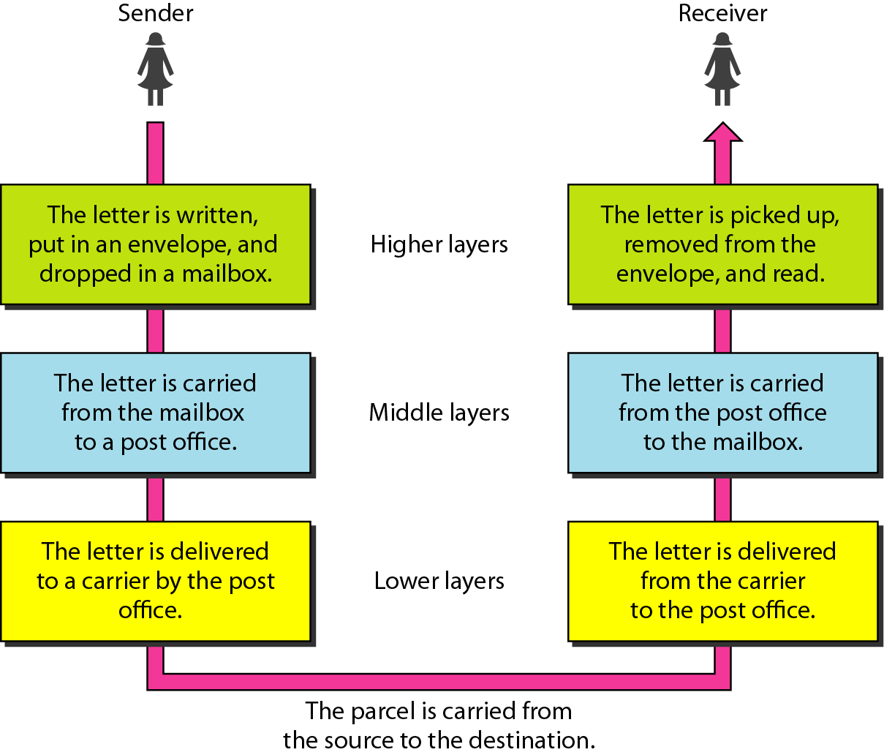
Layered Tasks, Example

Slide 4
THE OSI MODEL
Established in 1947, the International Standards Organization (ISO) is a multinational body dedicated to worldwide agreement on international standards. An ISO standard that covers all aspects of network communications is the Open Systems Interconnection (OSI) model. It was first introduced in the late 1970s.
Note:
ISO is the organization.
OSI is the model.

Slide 5
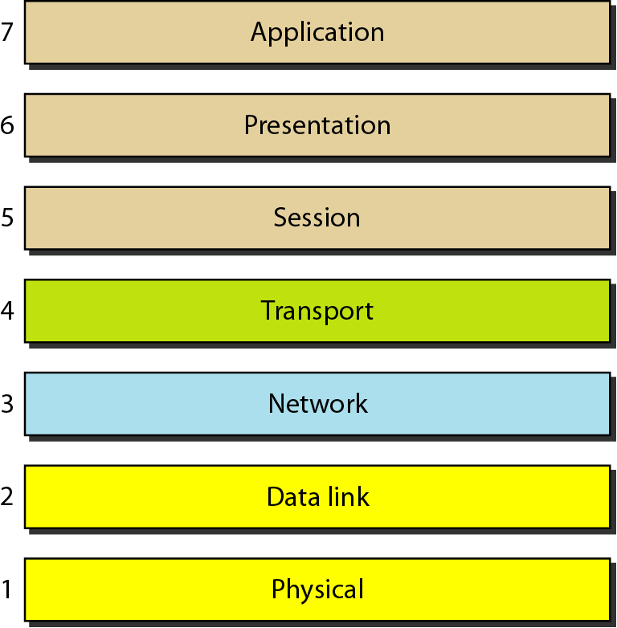
Seven layers of the OSI model

Slide 6
All people seem to need data processing.“
All = Application Layer
People = Presentation Layer
Seem = Session Layer
To = Transport Layer
Need =
Network Layer
Data = Data Link Layer
Processing = Physical Layer

Slide 7
PLEASE DO NOT TOUCH STEVE’ S PET ALLIGATOR
OSI Layers Mnemonic
Layer 1: Physical = Please.
Layer 2: Data Link = Do.
Layer 3: Network = Not.
Layer 4: Transport = Touch.
Layer 5: Session = Steve's.
Layer 6: Presentation = Pet.
Layer 7: Application = Alligator

Slide 8
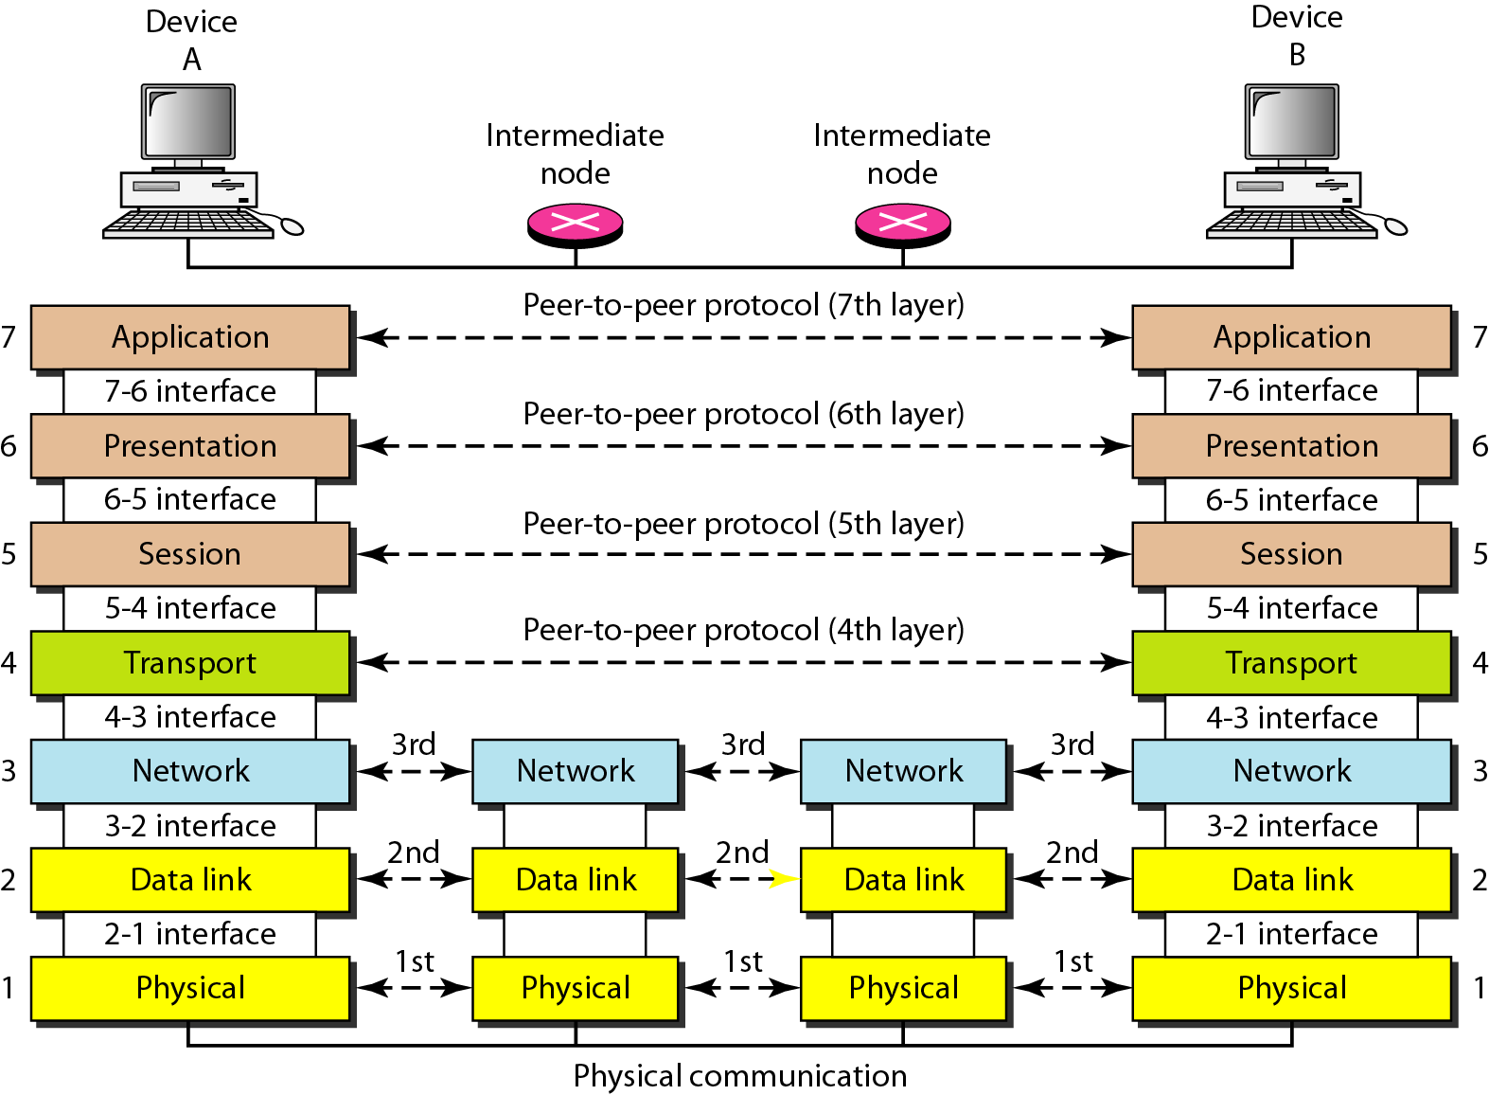
Interfaces b/w Layers

Slide 9
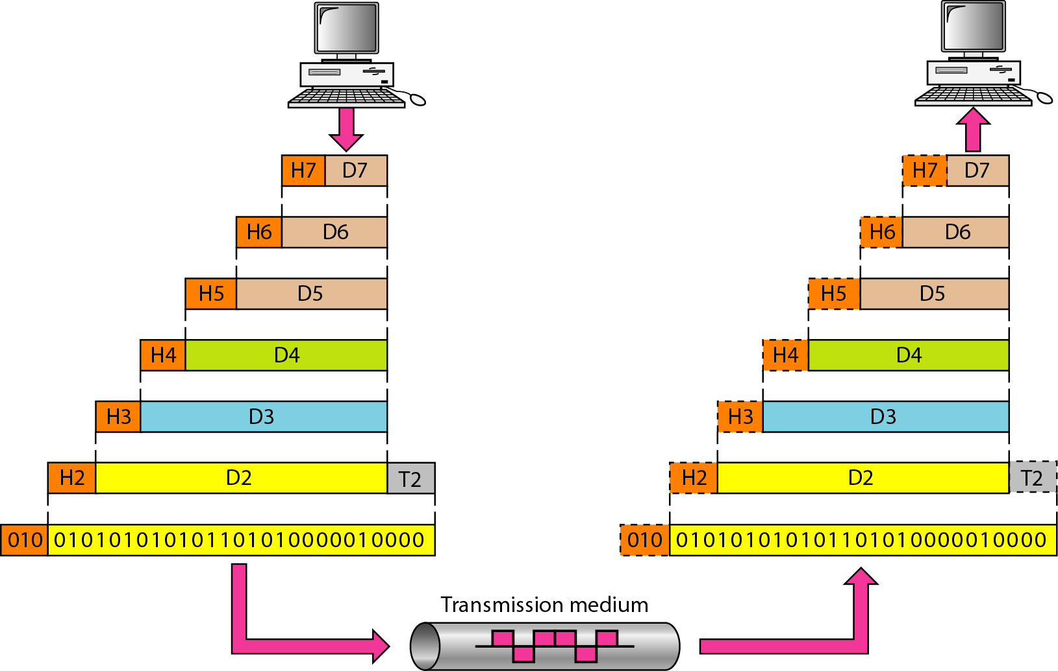
Exchange using the OSI Model

Slide 10
LAYERS IN THE OSI MODEL
Physical Layer
Data Link Layer
Network Layer
Transport Layer
Session Layer
Presentation Layer
Application Layer

Slide 11
Physical Layer
The physical layer is responsible for movements of individual bits from one hop (node) to the next.
Physical characteristics of interface and medium: pin assignment, connector, cables
Representation of bits: encoding
Data rate
Synchronization of bits
Line configuration: point-to-point, multipoint
Physical topology
Transmission mode: simplex, half-duplex, full-duplex

Slide 12
Data Link Layer
The data link layer is responsible for moving frames from one hop (node) to the next.
Framing
Physical addressing
Flow control
Error control
Access control

Slide 13
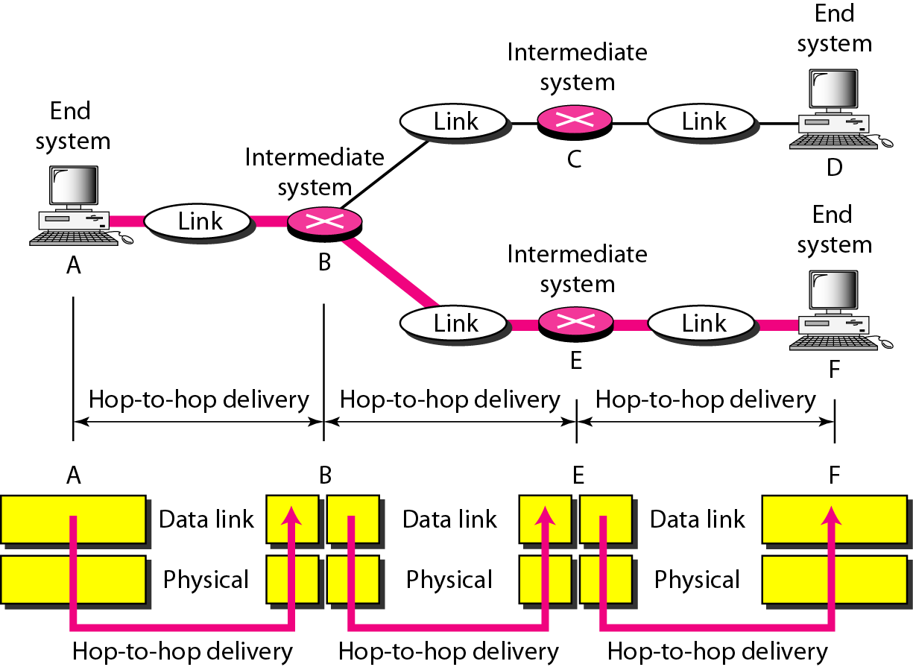
Hop-to-hop Delivery

Slide 14
Network Layer
The network layer is responsible for the delivery of individual packets from the source host to the destination host.
Logical addressing
Routing

Slide 15
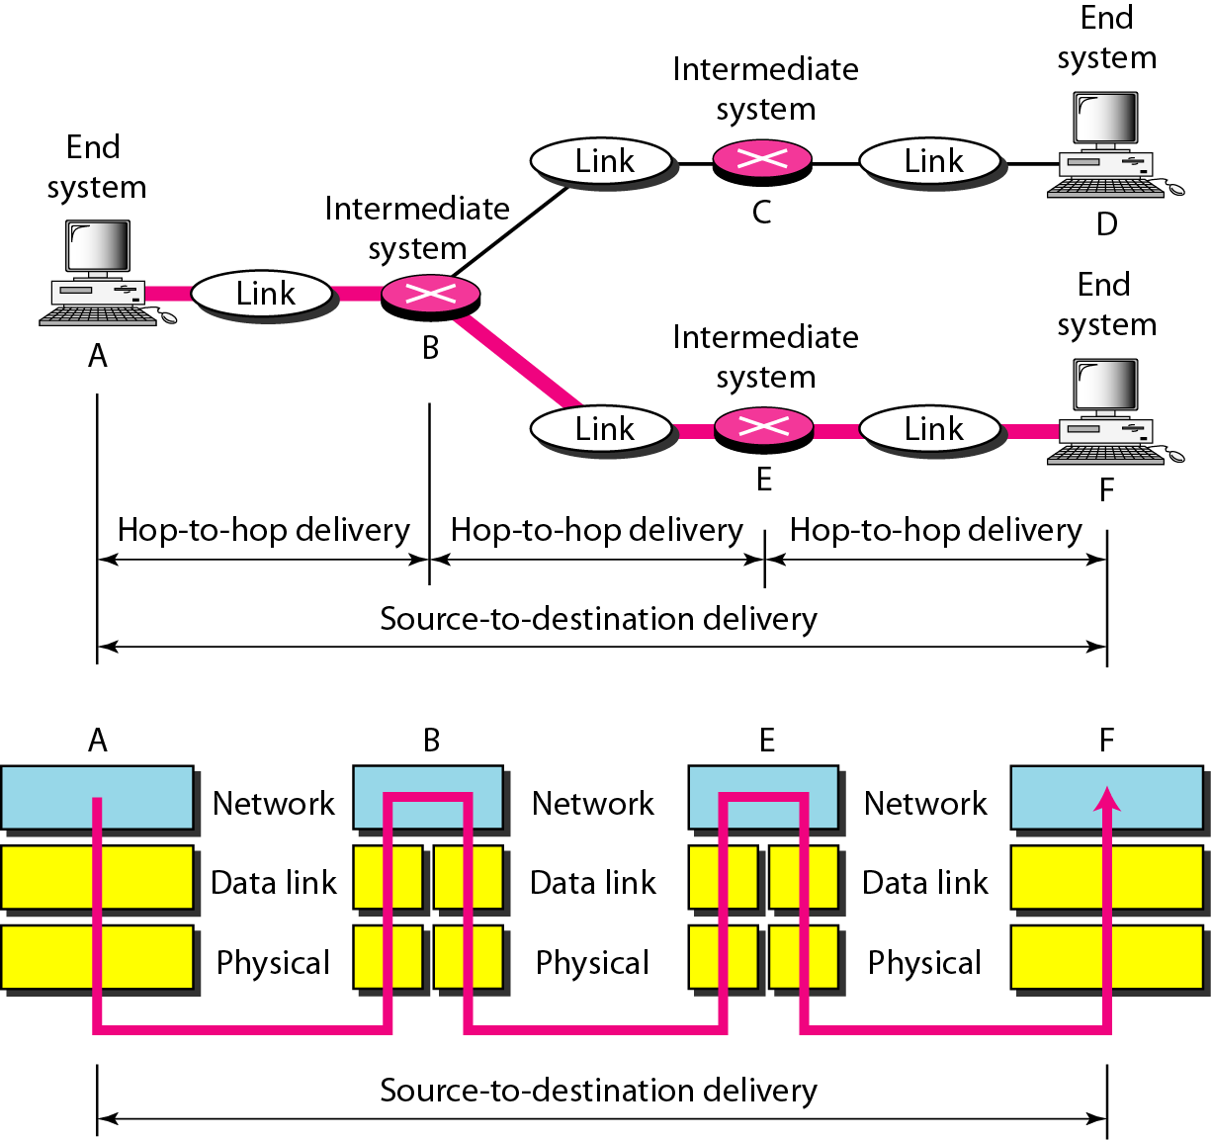
Source-to-destination delivery

Slide 16
Transport layer
The transport layer is responsible for the delivery of a message from one process to another.
Service-point addressing
Segmentation and reassembly
Connection control
Flow control
Error control

Slide 17
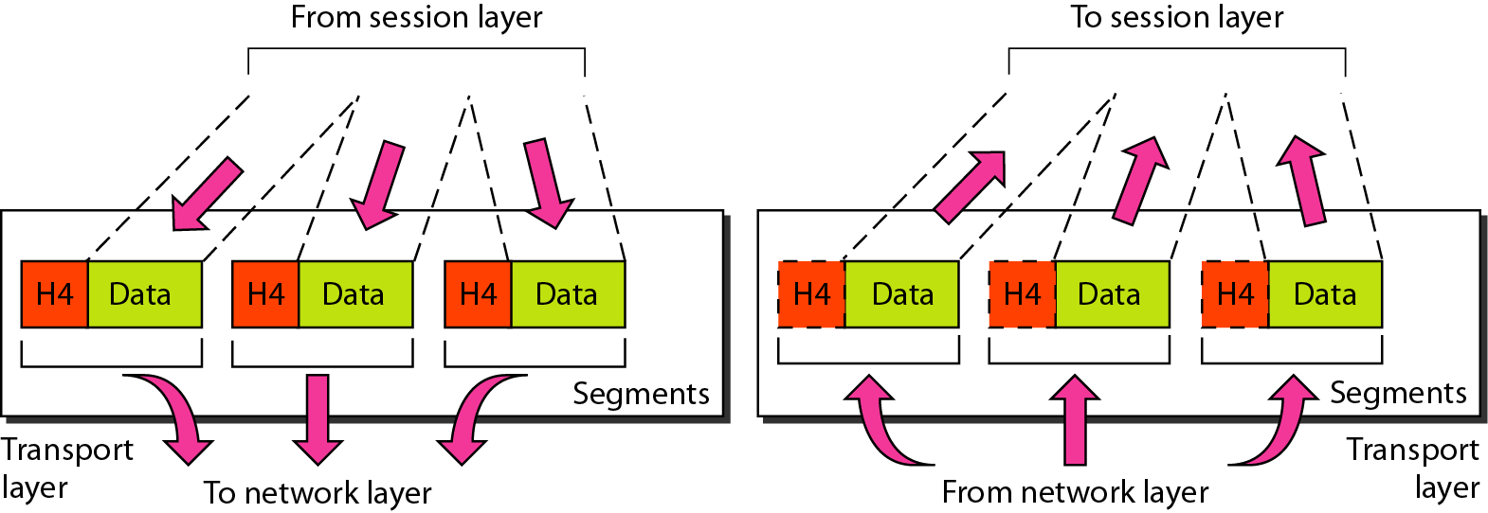
Segmentation and Reassembly

Slide 18
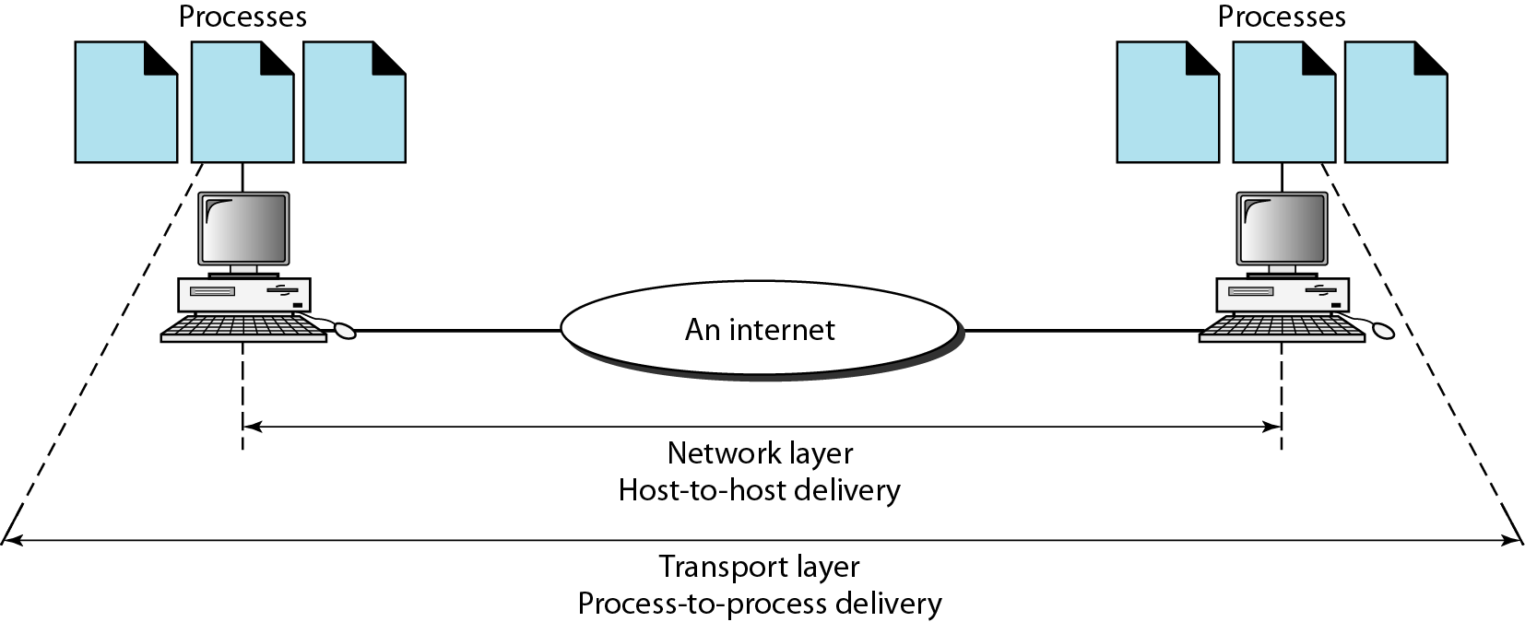
Reliable process-to-process delivery of a message

Slide 19
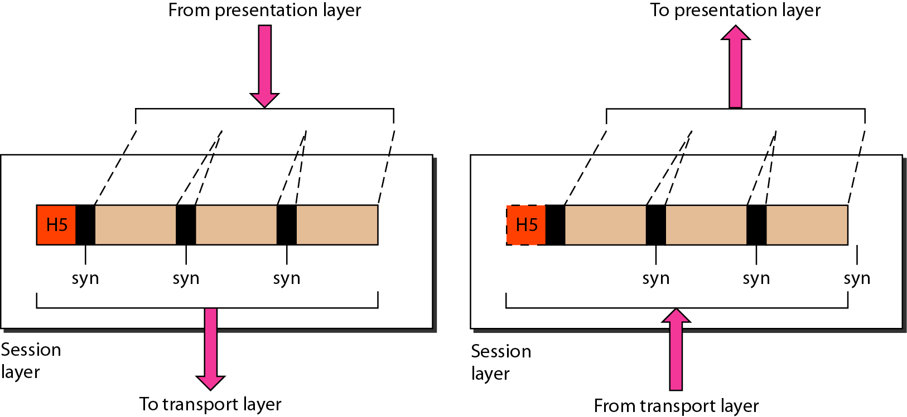
Session layer
The session layer is responsible for dialog control and synchronization.

Slide 20
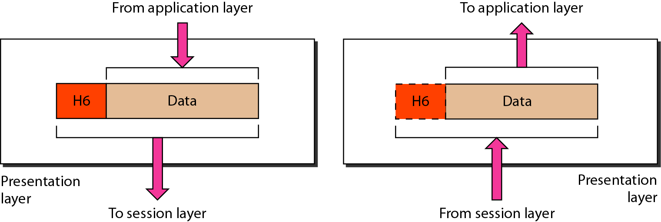
Presentation layer
It is concerned with the syntax and semantics of the information exchanged between two systems
The presentation layer is responsible for translation, compression, and encryption.

Slide 21
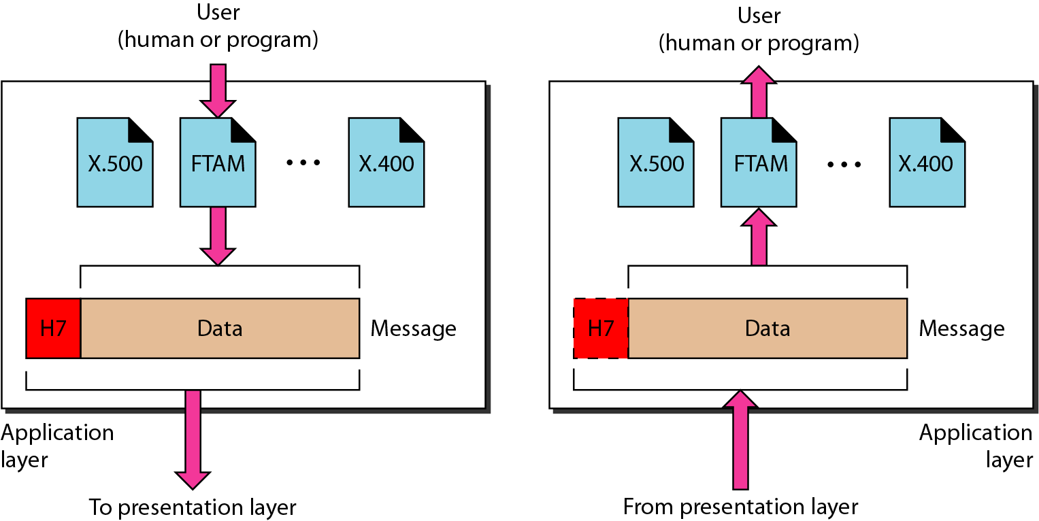
Application layer
The application layer is responsible for providing services to the user.
Functionalities are FTAM-File transfer &access management, Mail services and Directory services

Slide 22
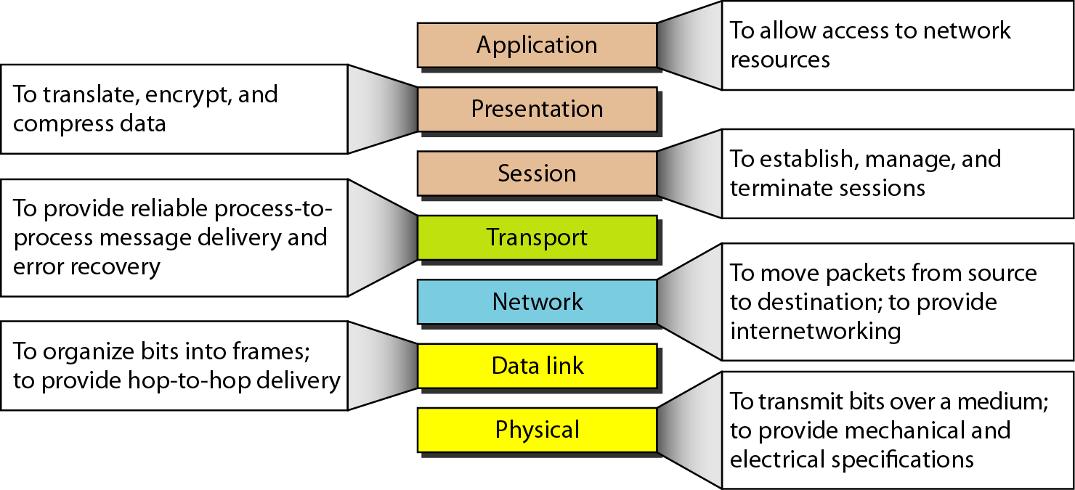
Summary of layers

Slide 23
TCP/IP PROTOCOL SUITE
The layers in the TCP/IP protocol suite do not exactly match those in the OSI model. The original TCP/IP protocol suite was defined as having four layers: host-to-network, internet, transport, and application. However, when TCP/IP is compared to OSI, we can say that the TCP/IP protocol suite is made of five layers: physical, data link, network, transport, and application.

Slide 24
WHY TCP/IP PROTOCOL SUITE
OSI doesn't define any particular protocol.
The session layer, which is used for session management, and the presentation layer, which deals with user interaction, aren't as useful as other layers in the OSI model.
.

Slide 25
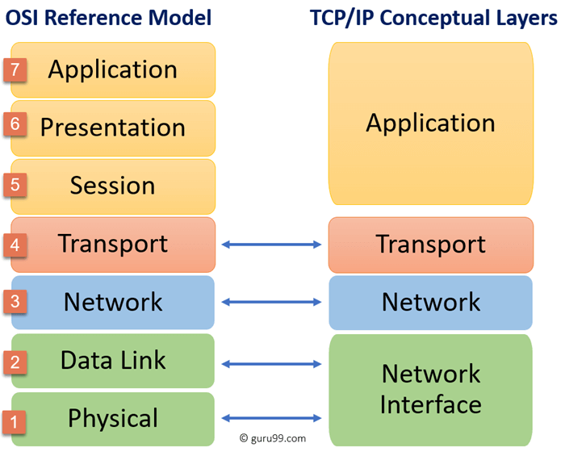

Slide 26
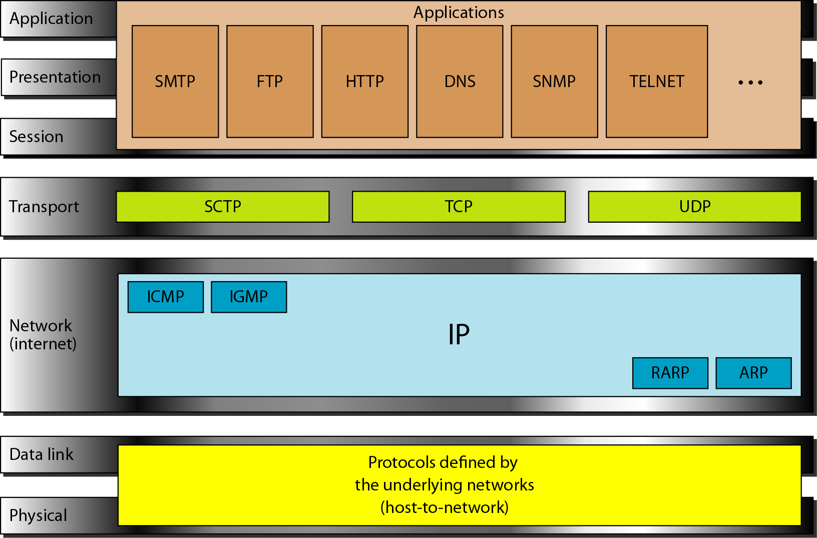
TCP/IP and OSI model

Slide 27
ADDRESSING
Four levels of addresses are used in an internet employing the TCP/IP protocols:
Physical address
Ex. Ehternet address, machine address
Logical address
IP address
Port number
Specific
URL, Email address, domain name

Slide 28
Network layer in TCP/IP
Address resolution
Reverse address resolution
Internet control message
Internet group message

Slide 29
Transport layer in TCP/IP
User Datagram Protocol (UDP)
Connectionless, unreliable
Transmission Control Protocol (TCP)
Connection-oriented, reliable
Stream Control Transmission Protocol (SCTP)
For supporting multimedia and VOIP

Slide 30
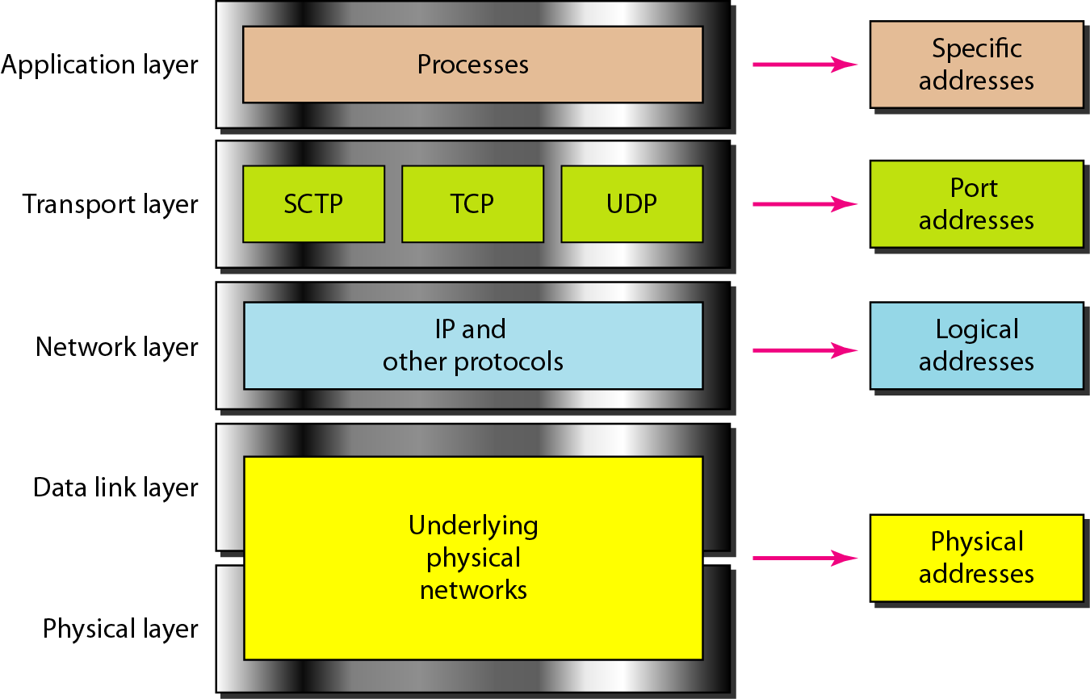
Relationship of layers and addresses in TCP/IP

Slide 31
Example 2.1
In Figure a node with physical address 10 sends a frame to a node with physical address 87. The two nodes are connected by a link (bus topology LAN). As the figure shows, the computer with physical address 10 is the sender, and the computer with physical address 87 is the receiver.

Slide 32
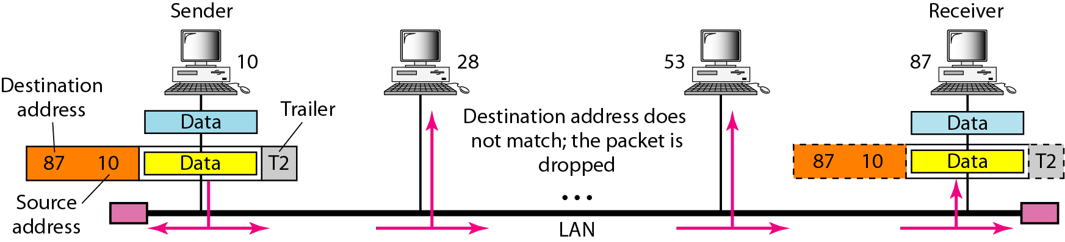
Physical addresses
The physical addresses will change from hop to hop,
but the logical addresses usually remain the same.

Slide 33
TCP/IP in a Network
data
data
IP
(1,2)
IP
(1,3)
data
1,2
data
1,2
1,3
1,3
NI
3487
NI
6537
data
3487
6537

Slide 34
Protocol Data Units PDU
PDUs are named according to the protocols of the TCP/IP suite:data, segment,packet ,frame and bits
Application layer – Data
Transport layer – Segment
Network layer – Packet
Data link layer – Frame
Physical layer - Bits

Slide 36
Example 2.2
As we will see in Chapter 13, most local-area networks use a 48-bit (6-byte) physical address written as 12 hexadecimal digits; every byte (2 hexadecimal digits) is separated by a colon, as shown below:
07:01:02:01:2C:4B

Slide 37
Example 2.3
Figure 2.20 shows a part of an internet with two routers connecting three LANs. Each device (computer or router) has a pair of addresses (logical and physical) for each connection. In this case, each computer is connected to only one link and therefore has only one pair of addresses. Each router, however, is connected to three networks (only two are shown in the figure). So each router has three pairs of addresses, one for each connection.

Slide 38
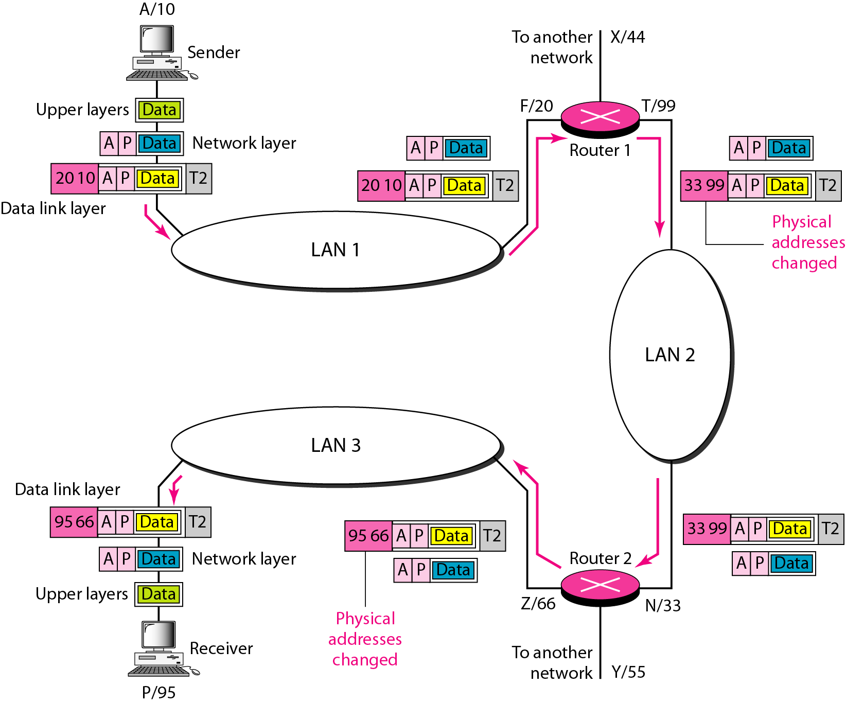
IP addresses

Slide 39
TCP/IP thru a Router
data
data
Host A
Router
Host B
IP
(1,2)
IP
(1,1) (2,3)
IP
(2,5)
data
1,2
data
1,2
data
1,2
2,5
2,5
2,5
NI
3487
NI
6543
NI
1002
NI
3903
data
3487
data
1002
6543
3903

Slide 40
Example 2.4
Figure 2.21 shows two computers communicating via the Internet. The sending computer is running three processes at this time with port addresses a, b, and c. The receiving computer is running two processes at this time with port addresses j and k. Process a in the sending computer needs to communicate with process j in the receiving computer. Note that although physical addresses change from hop to hop, logical and port addresses remain the same from the source to destination.

Slide 41
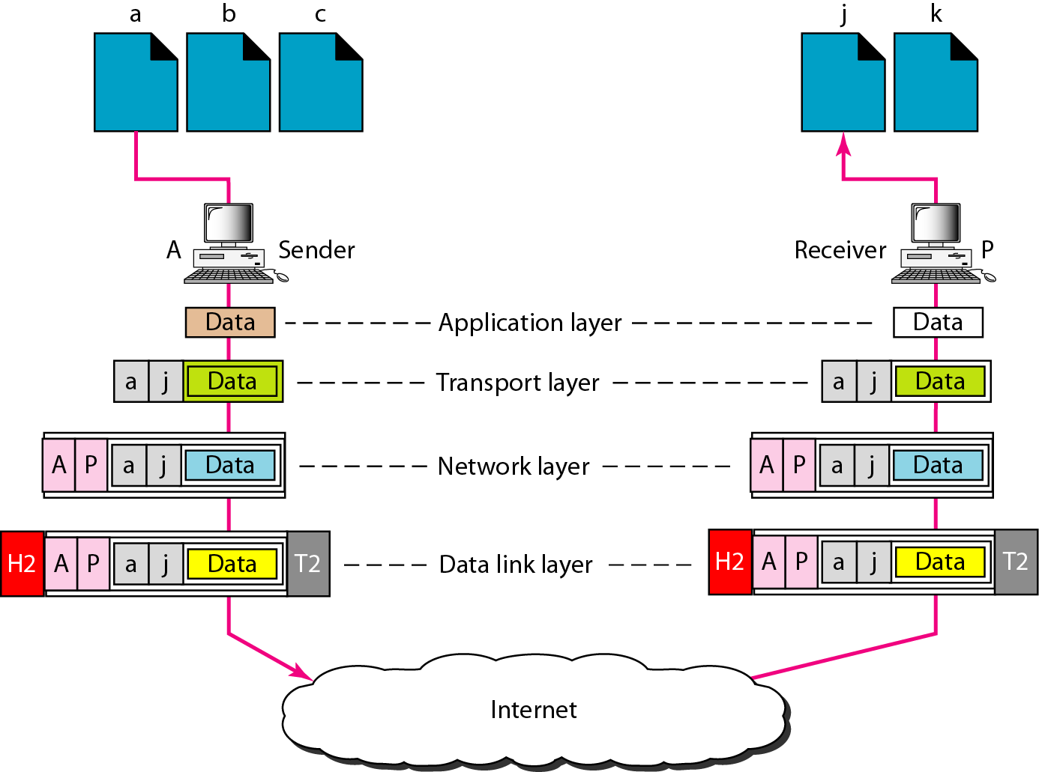
Port addresses

Slide 42
Example 2.5
As we will see in Chapter 23, a port address is a 16-bit address represented by one decimal number.

